Slide 1
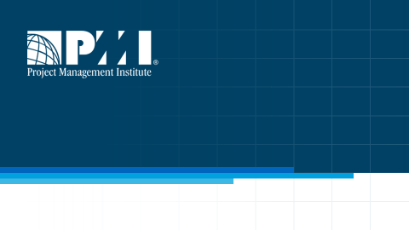

PMP ® EXAMINATION CONTENT OUTLINE
UPDATE-Dec 2019
July 2019 By: Reza M Rudd, PMP

Slide 2

Outline
PMP ® examination content outline update-2019
Key points in the new PMP ® examination content outline
A brief review of project management body of knowledge (PMBOK ^{®)}
The current versus the new PMP ® examination content outline
Conclusion
1
July 2019 By :Reza Rudd, PMP

Slide 3
PMP Exam-Why Change?
PMI ® continuously conducts research to understand how the profession has progressed, the impact of emerging trends, and how the responsibilities of project managers have changed.
The PMP ® is evolving just like the profession. Subject matter experts from leading organizations from around the world are currently working with PMI ® to define the PMP ® of the future.
In this year’s update to the PMP ® , PMI ® conducted a Global Practice Analysis market research study, which produced a number of trends in the profession previously unaddressed in the PMP ® exam. These trends were used as inputs into the Job Task Analysis and ensure the validity and relevance of the PMP ® examination.
These trends were used as inputs into the Job Task Analysis and ensure the validity and relevance of the PMP ® examination.
Validation assures the outcome of the exam is, in fact, measuring and evaluating appropriately the specific knowledge and skills required to function as a project management practitioner.
2
July 2019 By :Reza Rudd, PMP
July 2019 By :Reza Rudd, PMP
July 2019 By :Reza Rudd, PMP

Slide 4
PMP ® examination content outline update-Key points
The new PMP ® exam structure will come into effect from 16 December 2019.
About half of the examination will represent predictive project management approaches and the other half will represent agile or hybrid approaches
The new PMP ® exam questions fall in to three domains:
People, Processes and Business environment
3
July 2019 By :Reza Rudd, PMP
July 2019 By :Reza Rudd, PMP

Slide 5
PMBOK ® and PMP ® exam
The PMBOK ® sixth edition-2017 is the knowledge basis and framework for the PMP ® exam- current and the new- until the new version is released.
It is important to note that the volunteer taskforce involved in the study to develop the new PMP ® examination content outline were not bound by the PMBOK® Guide. The taskforce members were charged with outlining critical job tasks of individuals who lead and direct projects based on their experience and pertinent resources.
The PMBOK ® structure and approach to project management is totally different to of the PMP ® examination content outline and should not be mistaken. The PMP ® examination content outline is the evaluation and testing approach to the project management, not the knowledge framework.
The people who are looking to get their PMP ® should get prepared based on PMBOK ® and then get familiar with the PMP ® exam structure. They will need both their knowledge and their practical experience in project management to pass the PMP ® exam.
4
July 2019 By :Reza Rudd, PMP

Slide 6
A review to PMBOK ® framework
According to PMBOK ®, Projects’ life cycle can be predictive, adaptive( including Agile, Incremental or iterative) or Hybrid( a combination of two or more)
Projects pass trough project phases- The stages of the project which vary depending on the approaches and industry.
Projects are managed through PM processes
There are 49 Processes in PMBOK ® six edition
Each of These 49 processes have two separate affiliation:
Process group- there are 5 process groups:
Initiation, planning, execution, Monitoring & Control and closing
knowledge area: There are ten knowledge areas
Integration, scope, schedule, cost, resources, communication, stakeholders,
Quality , Risk and procurement
The above structure are illustrated in the next slides
5
July 2019 By :Reza Rudd, PMP

Slide 7

Project management
PM PROCESS GROUPS
Monitoring and control
5 Process
Groups
Consist of 49 processes
Planning
Initiating
Closing
Executing
6
Project management. Curtin University 2019

Slide 8










Project management
PM KNOWLEDGE AREAS
Scope
Schedule
Cost
Quality
procurement
Integration
Risk
Stakeholders
Resources
communication
7
Project management. Curtin University 2019

Slide 9
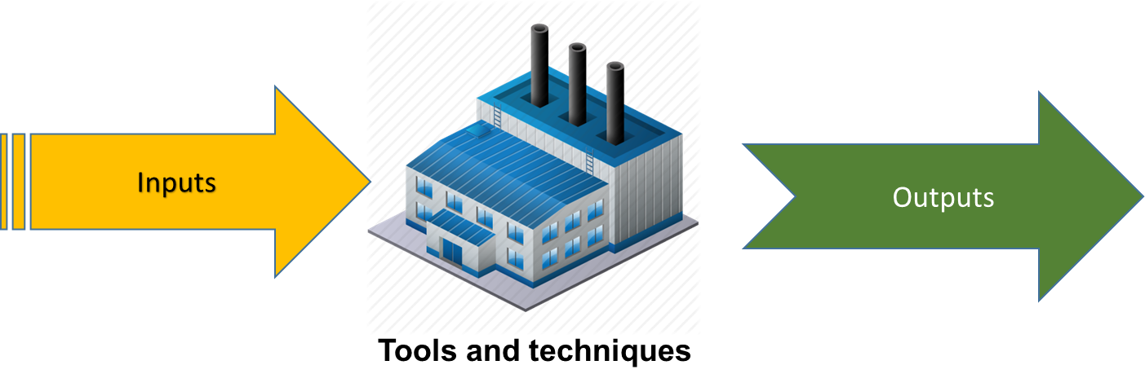
PM processes
Project management process
Each process belongs to one of the knowledge areas:
Integration
Scope
Schedule
cost
Quality
Risk
Communication
Procurement
Resources
Stakeholders
There are 49 processes in PMBOK
Process Group:
Process Knowledge area:
Each process belongs to one of the process groups:
Initiation, planning, execution, monitoring & control and closing
8
July 2019 By :Reza Rudd, PMP

Slide 10
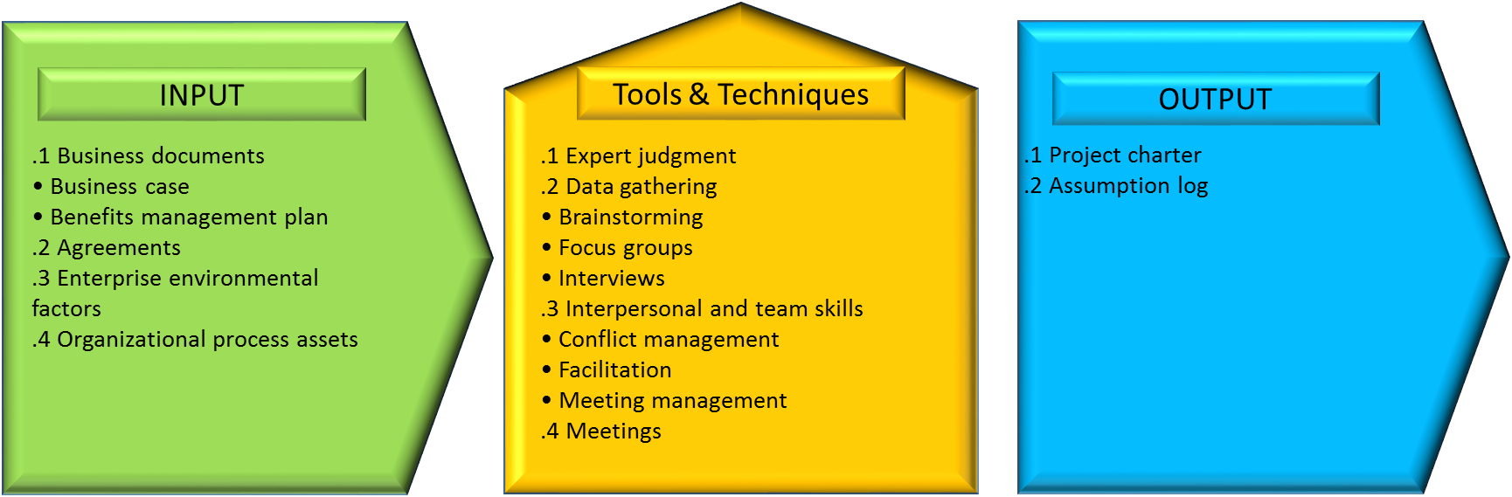
Structure of a typical PM process
4.1- Develop project charter
Each process belongs to one of the knowledge areas:
Integration
Scope
Schedule
cost
Quality
Risk
Communication
Procurement
Resources
Stakeholders
Initiation
Integration
Each process belongs to one of the process groups:
Initiation, planning, execution, monitoring & control and closing
9
July 2019 By :Reza Rudd, PMP

Slide 11
Project management
All 49 Processes in 5 groups and 10 knowledge areas
Different colours are used to show the process affiliation to knowledge areas49 PM
4.1 Develop project Charter
4.2 Develop Project management Plan
5.1 Plan scope management
5.2 Collect requirement
5.3 Define scope
5.4 create WBS
Scope baseline
9.3 Acquire resources
8.2 Manage Quality
13.1 Identify Stakeholders
Initiating process group
Planning process groups
10.2 Manage communications
9.4 Develop team
7.1 Plan Cost Management
6.5 Develop Schedule
6.4 Estimate activity durations
6.3 Sequence Activities
6.2 Define activities
6.1 Plan Schedule management
4.3 Direct and Manage project work
9.5 Manage Team
12.2 Conduct Procurement
4.4 Manage project knowledge
7.2 Estimate costs
7.3 Determine Budget
8.1 Plan Quality management
9.1 Plan Resources Management
9.2 Estimate Activity resources
13.2 Plan Stakeholder Engagement
10.1 Plan communication management
13.3 Manage Stakeholder
Engagement
11.6 Implement Risk Response
12.1 Plan Procurement Management
11.5 Plan Risk Response
11.4 Perform Quantitative Risk Analysis
11.3 Perform Qualitative Risk Analysis
11.2 Identify Risk
11.1 Plan Risk Management
Executing process group
13.4 Monitor Stakeholder Engagement
5.6 Control scope
4.5 Monitor and control Project Work
8.3 Control Quality
12.3 Control Procurement
5.5 Validate scope
4.7 Close Project or Phase
4.6 Perform integrated change control
Monitoring and control process groups
10.3 Monitor communications
11.7 Monitor Risk
7.4 Control Cost
9.6 Control resources
6.6 Control Schedule
Closing process group
Integration
Scope
Management
Schedule management
Cost Management
Quality Management
Resources Management
Communications management
Risk Management
Procurement Management
Stakeholder
Management
10
Project management. Curtin University 2019

Slide 12
PMP examination content outline
To evaluate applicants’ knowledge in project management, there is a different approach which is reflected in PMP ® exam content outline .
In PMP ® exam, questions are divided to Domains
Each domain in the exam contains a number of Tasks
The applicant capability and knowledge in tackling and fulfilling these tasks are evaluated and examined in the form of questions.
Again, this is the PMP ® exam approach and the essential Knowledge, skills and tools and techniques are the contents of PMBOK ®
11
July 2019 By :Reza Rudd, PMP

Slide 13
Current PMP ® VS New PMP ®
Project life cycle:
Due to the new industries requirements, more emphasis is put on the adaptive life cycle. Therefore, About half of the examination will represent predictive project management approaches and the other half will represent agile or hybrid approaches
Domains:
In the current PMP exam content outline, the domains are:
- Initiating, planning, execution, Monitoring&controlling and closing
These domains will be changed in the new outline to:
- People, process and business environment
The related tasks are changes accordingly
12
July 2019 By :Reza Rudd, PMP

Slide 14
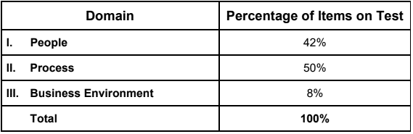
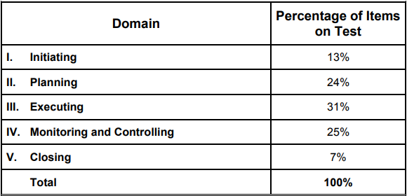
PMP ® exam domains- percentage
Current PMP exam Structure
New PMP exam Structure
13
July 2019 By :Reza Rudd, PMP

Slide 15
New PMP ® exam- Clarification
The new domains are the result of PMI ® work on simplifying the format so that the PMP Examination Content Outline is easier to understand and interpret.
The “people” domain covers all the project activities, tasks and tools and techniques that relate to people - Project team, and stakeholders. This domain can be related to any of the 10 Knowledge areas such as stakeholders, communication, resources, risk , etc…
The “process” domain addresses all the project activities, tasks and tools and techniques which are in form of processes in any of 10 knowledge areas; such as planning and managing scope , schedule, etc…
The “Business environment” domain focuses on the project activities, tasks and tools and techniques that are related to the projects environment such as Evaluate and address external business environment changes for impact on scope
14
July 2019 By :Reza Rudd, PMP

Slide 16
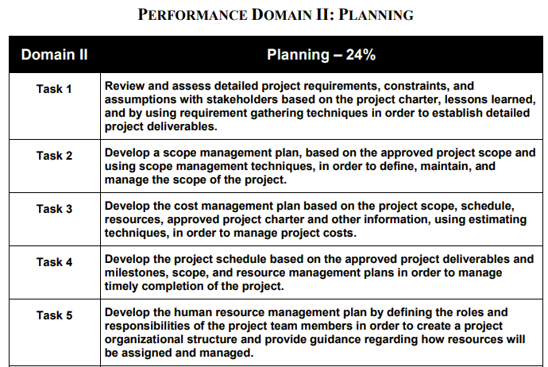
Current PMP ® exam tasks example
15
July 2019 By :Reza Rudd, PMP

Slide 17
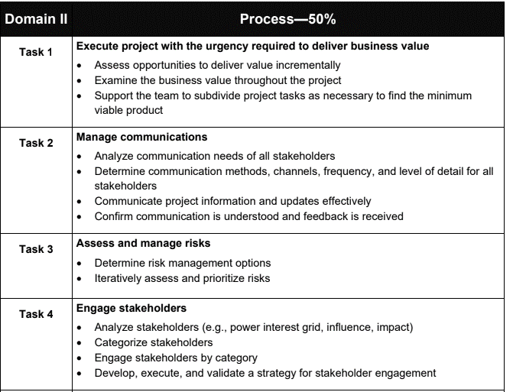
New PMP ® exam tasks examples
16
July 2019 By :Reza Rudd, PMP

Slide 18
Conclusion
PMI ® has updated the PMP ® examination content outline to address the emerging requirements of project management in the present fast-changing world.
The new PMP ® examination content outline will come into effect
from 16 December 2019
In the new PMP ® examination content outline the domains has been simplified and changed to People, Processes and Business environment.
The domains and associated tasks are just the evaluation and testing approach, not the project management framework.
The PMBOK ® sixth edition is the knowledge basis of the new PMP exam. The project management framework addressed in PMBOK ® in unchanged. However, It is important to note that the new PMP ® examination content outline is not bound by the PMBOK® Guide. The PMP ® exam evaluates the ability of individuals who lead and direct projects to tackle critical job tasks based on their experience and pertinent resources.
17
July 2019 By :Reza Rudd, PMP

Slide 19
Resources
A guide to the Project management body of knowledge(PMBOK ® Guide) , Sixth Edition, PMI ®
PMP® Certification Handbook, PMI ®, 2019
Project Management Professional (PMP)® Examination Content Outline
For December 2019 Exam Update, PMI ®, June 2019
Project Management Professional (PMP)® Examination Content Outline, PMI®, June 2015
17
July 2019 By :Reza Rudd, PMP

Slide 20

Project management
Thank you for your attention
end
Project management. Curtin University 2019

